Slide 1

SOFTWARE ENGINEERING(M23DE0104)
Academic Year:2024-2025, ODD Semester
MCA I Semester, School of CSA
Dr. N. Kavitha
Professor

Slide 2
Unit-iI
Software Requirement Engineering
Functional and Non-Functional Requirements (IEEE standard), The Software Requirements Document, Requirements Specification, Requirements Engineering Processes, Requirement Elicitation and Analysis, Requirements Validation, Requirements Management, Software Cost Estimation, Requirements Modelling, Design concepts, Function Oriented Design, Detailed Design, Architectural

Slide 3
Learning objectives
The objective of this unit is to introduce software requirements and to discuss the processes involved in discovering and documenting these requirements. At end of the unit you will:
understand the concepts of user and system requirements and why these requirements should be written in different ways
understand the differences between functional and nonfunctional software requirements
understand how requirements may be organized in a software requirements document
understand the principal requirements engineering activities of elicitation, analysis and validation, and the relationships between these activities
understand why requirements management is necessary and how it supports other requirements engineering activities

Slide 4
LECTURE-1 : Introduction

Slide 5
requirements engineering (RE)
The requirements for a system are the descriptions of what the system should do— the services that it provides and the constraints on its operation. These requirements reflect the needs of customers for a system that serves a certain purpose such as controlling a device, placing an order, or finding information. The process of finding out, analyzing, documenting and checking these services and constraints is called requirements engineering (RE).

Slide 6
The term ‘requirement’ is not used consistently in the software industry. In some cases, a requirement is simply a high-level, abstract statement of a service that a system should provide or a constraint on a system. At the other extreme, it is a detailed, formal definition of a system function.
Distinguish between them by using the term ‘user requirements’ to mean the high-level abstract requirements and ‘system requirements’ to mean the detailed description of what the system should do.

Slide 7
User requirements and system requirements may be defined as follows:
User requirements are statements, in a natural language plus diagrams, of what services the system is expected to provide to system users and the constraints under which it must operate.
System requirements are more detailed descriptions of the software system’s functions, services, and operational constraints. The system requirements docu ment (sometimes called a functional specification) should define exactly what is to be implemented. It may be part of the contract between the system buyer and the software developers.

Slide 8
Example: Mental health care patient management system (MHC-PMS)

Slide 9
Figure 4.2 shows possible readers of the user and system requirements. The readers of the user requirements are not usually concerned with how the system will be implemented and may be managers who are not interested in the detailed facilities of the system. The readers of the system requirements need to know more precisely what the system will do because they are concerned with how it will support the business processes or because they are involved in the system implementation.

Slide 10
LECTURE 2: FUNCTIONAL AND NON FUNCTIONAL REQUIREMENTS

Slide 11
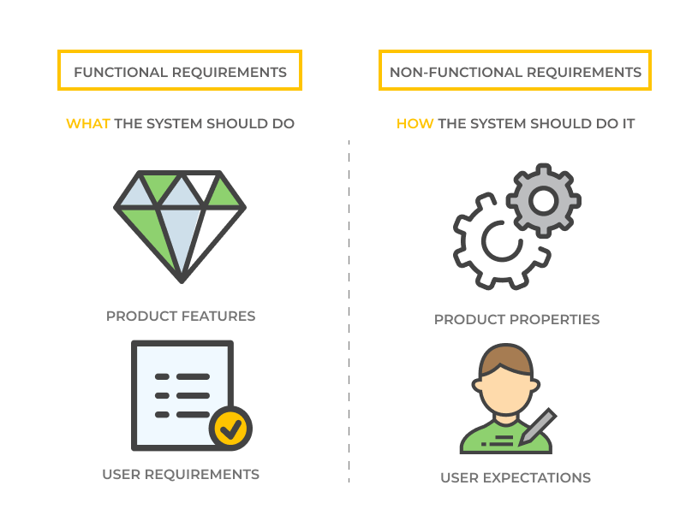
Functional and non-functional requirements
Software system requirements are often classified as functional requirements or non functional requirements:
Functional requirements:
These are statements of services the system should provide, how the system should react to particular inputs, and how the system should behave in particular situations. In some cases, the functional requirements may also explicitly state what the system should not do.
2. Non-functional requirements
These are constraints on the services or functions offered by the system. They include timing constraints, constraints on the development process, and constraints imposed by standards. Non-functional requirements often apply to the system as a whole, rather than individual system features or services.

Slide 12
Functional requirements
The functional requirements for a system describe what the system should do. These requirements depend on the type of software being developed, the expected users of the software, and the general approach taken by the organization when writing requirements.
When expressed as user requirements, functional requirements are usually described in an abstract way that can be understood by system users. However, more specific functional system requirements describe the system functions, its inputs and outputs, exceptions, etc., in detail.
Functional system requirements vary from general requirements covering what the system should do to very specific requirements reflecting local ways of working or an organization’s existing systems.

Slide 13
examples of functional requirements for the MHC-PMS system
Used to maintain information about patients receiving treatment for mental health problems:
A user shall be able to search the appointments lists for all clinics.
The system shall generate each day, for each clinic, a list of patients who are expected to attend appointments that day.
Each staff member using the system shall be uniquely identified by his or her eight-digit employee number
These functional user requirements define specific facilities to be provided by the system. These have been taken from the user requirements document and they show that functional requirements may be written at different levels of detail.

Slide 14
Problems arise when functional requirements are not precisely stated.
Ambiguous requirements may be interpreted in different ways by developers and users.
Consider the term ‘search’ in requirement 1
  User intention – search for a patient name across all appointments in all clinics;
  Developer interpretation – search for a patient name in an individual clinic. User chooses clinic then search.

Slide 15
In principle, requirements should be both complete and consistent.
Complete
  They should include descriptions of all facilities required.
Consistent
  There should be no conflicts or contradictions in the descriptions of the system facilities.
In practice, because of system and environmental complexity, it is impossible to produce a complete and consistent requirements document.

Slide 16
Other Examples of Functional Requirements:
In an online banking system:
  The system must allow users to transfer money between accounts.
  The system should send an email confirmation after a transaction.
In a library management system:
  The system must allow users to search for books by title, author, or genre.
  The system should issue due date reminders for borrowed books.

Slide 17
Non-functional requirements
These define system properties and constraints e.g. reliability, response time and storage requirements. Constraints are I/O device capability, system representations, etc.
Process requirements may also be specified mandating a particular IDE, programming language or development method.
Non-functional requirements may be more critical than functional requirements. If these are not met, the system may be useless.
Non-functional requirements arise through user needs, because of budget constraints, organizational policies, the need for interoperability with other software or hardware systems, or external factors such as safety regulations or privacy legislation.

Slide 18
Types of non-functional requirement

Slide 19
Non-functional requirements implementation
The implementation of these requirements may be diffused throughout the system. There are two reasons for this
Non-functional requirements may affect the overall architecture of a system rather than the individual components.
  For example, to ensure that performance requirements are met, you may have to organize the system to minimize communications between components.
A single non-functional requirement, such as a security requirement, may generate a number of related functional requirements that define system services that are required.
  It may also generate requirements that restrict existing requirements.

Slide 20
The non-functional requirements may come from required characteristics of the software (product requirements), the organization developing the software (organizational requirements), or from external sources:
Product requirements
  Requirements which specify that the delivered product must behave in a particular way e.g. execution speed, reliability, etc.
Organisational requirements
  Requirements which are a consequence of organisational policies and procedures e.g. process standards used, implementation requirements, etc.
External requirements
  Requirements which arise from factors which are external to the system and its development process e.g. interoperability requirements, legislative requirements, etc.

Slide 21
Examples of nonfunctional requirements in the Mentcare system
Product requirement The Mentcare system shall be available to all clinics during normal working hours (Mon–Fri, 0830–17.30). Downtime within normal working hours shall not exceed five seconds in any one day. Organizational requirement Users of the Mentcare system shall authenticate themselves using their health authority identity card. External requirement The system shall implement patient privacy provisions as set out in HStan-03-2006-priv.

Slide 22
Types of non-functional requirement
4. Efficiency Requirements
These define the system’s required performance level, like speed or resource usage.
Example: The product search feature should return results in under 2 seconds.
Scenario: A customer quickly finds the products they’re looking for, improving shopping experience.
5. Dependability Requirements
Focuses on system reliability and fault tolerance.
Example: The website must recover from failures within 30 minutes.
Scenario: If the site crashes, it should automatically restart and continue without losing user data.
6. Security Requirements
Specifies how the system should protect data and prevent unauthorized access.
Example: User passwords must be stored encrypted in the database.
Scenario: Customers’ payment details should be secured through encryption when entering them.

Slide 23
Types of non-functional requirement
7. Regulatory Requirements
These ensure the system complies with laws or standards.
Example: The system must comply with GDPR data protection regulations.
Scenario: The system must notify users of data usage and allow them to delete their data.
8. Ethical Requirements
Focus on ensuring that the system adheres to ethical practices.
Example: The website should not track users without their consent.
Scenario: Customers should be able to opt-out of data collection and tracking
9. Usability Requirements
Defines how easy and user-friendly the system should be.
Example: The website must have an intuitive user interface that’s easy for non-technical users.
Scenario: A first-time user should be able to navigate the website and complete a purchase with no assistance.
Notes:
General Data Protection Regulation

Slide 24
Types of non-functional requirement
10. Environmental Requirements
Specifies how the system interacts with its environment, like hardware or physical factors.
Example: The system must be compatible with both Windows and Mac operating systems.
Scenario: The website must be accessible on different devices and browsers.
11. Operational Requirements
Defines the system’s operational aspects, like deployment or maintenance needs.
Example: The website should have an automatic backup feature every night.
Scenario: To avoid data loss, the website backs up all user data automatically during off-hours.
12. Development Requirements
These define constraints for development, like programming languages or tools.
Example: The website should be developed using React.js and Node.js.
Scenario: The development team uses specific tools for faster front-end development and back-end communication.

Slide 25
Types of non-functional requirement
13. Legislative Requirements
These refer to legal or regulatory obligations the system must follow.
Example: The website must provide accessible services for users with disabilities (e.g., WCAG compliance).
Scenario: The website follows guidelines to ensure accessibility for users with visual impairments.
14. Performance Requirements
Specifies how well the system should perform under various conditions.
Example: The website must handle 5000 concurrent users without slowing down.
Scenario: During a flash sale, the site handles a large number of users without crashing.
15. Space Requirements
Defines how much memory, storage, or space the system needs to operate effectively.
Example: The website should not exceed 10 GB of disk space for user data.
Scenario: The site optimizes data storage to keep it within the specified limit.
Notes:
Web Content Accessibility Guidelines compliance

Slide 26
Types of non-functional requirement
16. Accounting Requirements
Requirements related to financial calculations, transactions, and record-keeping.
Example: The system must track sales tax for every transaction.
Scenario: When customers make a purchase, the system calculates the appropriate tax based on location.
17. Safety/Security Requirements
Focuses on ensuring the system is protected from security threats or failures.
Example: The website should prevent unauthorized access to user accounts through multi-factor authentication.
Scenario: Users must authenticate with both a password and an OTP (one-time password) for added security.

Slide 27
Non-functional requirements may be very difficult to state precisely and imprecise requirements may be difficult to verify.
Goal
  A general intention of the user such as ease of use.
Verifiable non-functional requirement
  A statement using some measure that can be objectively tested.
Goals are helpful to developers as they convey the intentions of the system users.
The system should be easy to use by medical staff and should be organized in such a way that user errors are minimized. (Goal)
Medical staff shall be able to use all the system functions after four hours of training. After this training, the average number of errors made by experienced users shall not exceed two per hour of system use. (Testable non-functional requirement)

Slide 28
Metrics for specifying nonfunctional requirements
Property | Measure
Speed | Processed transactions/second User/event response time Screen refresh time
Size | Mbytes Number of ROM chips
Ease of use | Training time Number of help frames
Reliability | Mean time to failure Probability of unavailability Rate of failure occurrence Availability
Robustness | Time to restart after failure Percentage of events causing failure Probability of data corruption on failure
Portability | Percentage of target dependent statements Number of target systems

Slide 29
NON FUNCTIONAL requirement
Examples of Non-Functional Requirements:
Performance:
  The system should process 10,000 transactions per minute.
Scalability:
  The system must support an increasing number of users up to 1 million.
Reliability:
  The system should have 99.9% uptime.
Usability:
  The application should be easy to use for first-time users within 10 minutes.
Security:
  User data must be encrypted and comply with GDPR (General Data Protection Regulation)standards.

Slide 30
Scenario Example: Online Shopping Website
Aspect | Functional Requirements | Non-Functional Requirements
User Login | Users must be able to log in using a username and password. | Login must complete within 2 seconds.
Product Search | Users should be able to search for products by name, category, or price range. | Search results should load within 1 second for up to 1000 products.
Add to Cart | Users must be able to add selected products to the shopping cart. | The system should allow up to 50 items in the cart at one time.
Payment Processing | The system must process payments through credit cards, debit cards, or UPI. | Payment transactions must have 99.9% success reliability.
Order Confirmation | After payment, the system must generate an order confirmation email to the user. | The confirmation email should be sent within 5 minutes of successful payment.
Mobile Compatibility | The website should work on mobile devices. | The website should be responsive on devices with screen sizes of 5-10 inches.
Data Security | Users must have a secure session when entering personal or payment details. | All user data must be encrypted using AES-256 standards.
Scalability | Not directly applicable (functional requirements don’t cover this). | The website should handle up to 1,000 concurrent users without performance degradation.

Slide 31
Differences between Functional Requirements and Non-Functional Requirements
Aspect | Functional Requirements | Non-Functional Requirements
Definition | Describes what the system should do, i.e., specific functionality or tasks. | Describes how the system should perform, i.e., system attributes or quality.
Purpose | Focuses on the behavior and features of the system. | Focuses on the performance, usability, and other quality attributes.
Scope | Defines the actions and operations of the system. | Defines constraints or conditions under which the system must operate.
Examples | User authentication, data input/output, transaction processing. | Scalability, security, response time, reliability, maintainability.
Measurement | Easy to measure in terms of outputs or results. | More difficult to measure, often assessed using benchmarks or SLAs.
Impact on Development | Drives the core design and functionality of the system. | Affects the architecture and overall performance of the system.
Focus on User Needs | Directly related to user and business requirements. | Focuses on user experience and system performance.
Documentation | Typically documented in use cases, functional specifications, etc. | Documented through performance criteria, technical specifications, etc.
Evaluation | Can be tested through functional testing (e.g., unit or integration tests). | Evaluated through performance testing, security testing, and usability testing.
Dependency | Determines what the system must do to meet user needs. | Depends on how well the system performs the required tasks.

Slide 32
The software requirements document

Slide 33
The software requirements document (sometimes called the software requirements specification or SRS) is an official statement of what the system developers should implement.
It should include both the user requirements for a system and a detailed specification of the system requirements.
If there are a large number of requirements, the detailed system requirements may be presented in a separate document.
Requirements documents are essential when an outside contractor is developing the software system.

Slide 34
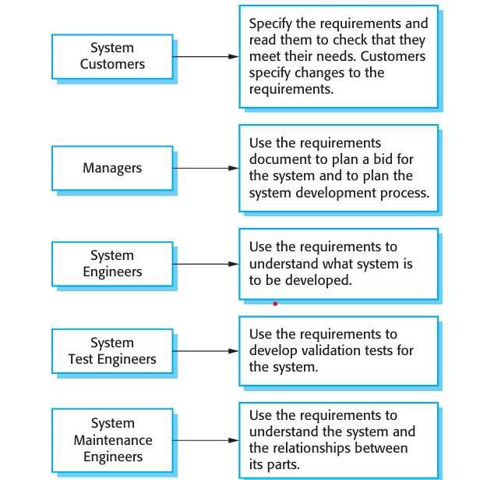
The requirements document has a diverse set of users, ranging from the senior management of the organization that is paying for the system to the engineers responsible for developing the software.
Figure: Users of a requirements document

Slide 35
The diversity of possible users means that the requirements document has to be a compromise between communicating the requirements to customers, defining the requirements in precise detail for developers and testers, and including information about possible system evolution.
Information on anticipated changes can help system designers avoid restrictive design decisions and help system maintenance engineers who have to adapt the system to new requirements.
The level of detail that you should include in a requirements document depends on the type of system that is being developed and the development process used.

Slide 36
Critical systems need to have detailed requirements because safety and security have to be analyzed in detail.
When the system is to be developed by a separate company (e.g., through outsourcing), the system specifications need to be detailed and precise. If an in house, iterative development process is used, the requirements document can be much less detailed and any ambiguities can be resolved during development of the system.

Slide 37
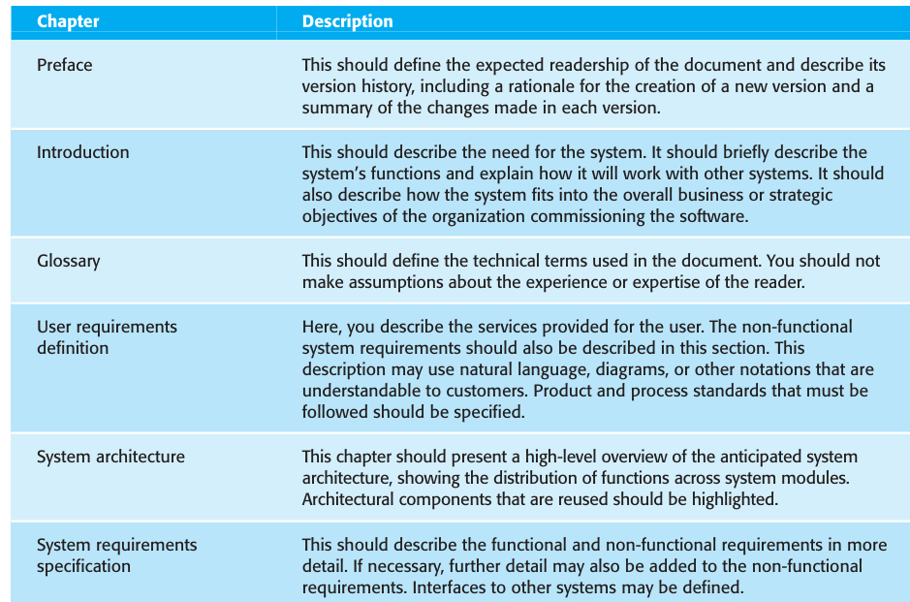
Figure shows one possible organization for a requirements document that is based on an IEEE standard for requirements documents (IEEE, 1998).

Slide 38
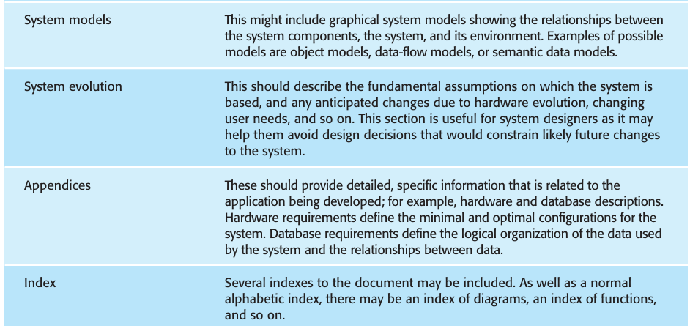

Slide 39
The information that is included in a requirements document depends on the type of software being developed and the approach to development that is to be used. If an evolutionary approach is adopted for a software product , the requirements document will leave out many of detailed chapters.
The focus will be on defining the user requirements and high-level, non-functional system requirements. In this case, the designers and programmers use their judgment to decide how to meet the outline user requirements for the system.
However, when the software is part of a large system project that includes interacting hardware and software systems, it is usually necessary to define the requirements to a fine level of detail.

Slide 40
Requirements specification

Slide 41
Requirements specification is the process of writing down the user and system requirements in a requirements document.
The user and system requirements should be clear, unambiguous, easy to understand, complete, and consistent.
The user requirements for a system should describe the functional and non functional requirements so that they are understandable by system users who don’t have detailed technical knowledge.
Ideally, they should specify only the external behavior of the system. The requirements document should not include details of the system architecture or design.

Slide 42
Consequently, if you are writing user requirements, you should not use software jargon, structured notations, or formal notations. You should write user requirements in natural language, with simple tables, forms, and intuitive diagrams.
System requirements are expanded versions of the user requirements that are used by software engineers.
They add detail and explain how the user requirements should be provided by the system.
The system requirements should simply describe the external behavior of the system and its operational constraints. They should not be concerned with how the system should be designed or implemented. However, at the level of detail required to completely specify a complex software system, it is practically impossible to exclude all design information.

Slide 43
In principle, requirements should state what the system should do and the design should describe how it does this.
In practice, requirements and design are inseparable
  A system architecture may be designed to structure the requirements;
  The system may inter-operate with other systems that generate design requirements;
  The use of a specific architecture to satisfy non-functional requirements may be a domain requirement.

Slide 44
User requirements are almost always written in natural language supplemented by appropriate diagrams and tables in the requirements document. System requirements may also be written in natural language but other notations based on forms, graphical system models, or mathematical system models can also be used.
The following figure summarizes the possible notations that could be used for writing system requirements.

Slide 45
Ways of writing a system requirements specification
Notation | Description
Natural language | The requirements are written using numbered sentences in natural language. Each sentence should express one requirement.
Structured natural language | The requirements are written in natural language on a standard form or template. Each field provides information about an aspect of the requirement.
Design description languages | This approach uses a language like a programming language, but with more abstract features to specify the requirements by defining an operational model of the system. This approach is now rarely used although it can be useful for interface specifications.
Graphical notations | Graphical models, supplemented by text annotations, are used to define the functional requirements for the system; UML use case and sequence diagrams are commonly used.
Mathematical specifications | These notations are based on mathematical concepts such as finite-state machines or sets. Although these unambiguous specifications can reduce the ambiguity in a requirements document, most customers don’t understand a formal specification. They cannot check that it represents what they want and are reluctant to accept it as a system contract

Slide 46
Natural language specification
Requirements are written as natural language sentences supplemented by diagrams and tables.
Used for writing requirements because it is expressive, intuitive and universal. This means that the requirements can be understood by users and customers.

Slide 47
Guidelines for writing requirements
Invent a standard format and use it for all requirements.
Use language in a consistent way.
Use text highlighting to identify key parts of the requirement.
Avoid the use of computer jargon.
Include an explanation (rationale) of why a requirement is necessary.

Slide 48
Problems with natural language
Lack of clarity
  Precision is difficult without making the document difficult to read.
Requirements confusion
  Functional and non-functional requirements tend to be mixed-up.
Requirements amalgamation
  Several different requirements may be expressed together.

Slide 49
Example requirements for the insulin pump software system
3.2 The system shall measure the blood sugar and deliver insulin, if required, every 10 minutes. (Changes in blood sugar are relatively slow so more frequent measurement is unnecessary; less frequent measurement could lead to unnecessarily high sugar levels.) 3.6 The system shall run a self-test routine every minute with the conditions to be tested and the associated actions defined in Table 1. (A self-test routine can discover hardware and software problems and alert the user to the fact the normal operation may be impossible.)

Slide 50
Structured specifications
An approach to writing requirements where the freedom of the requirements writer is limited and requirements are written in a standard way.
This works well for some types of requirements e.g. requirements for embedded control system but is sometimes too rigid for writing business system requirements.

Slide 51
Form-based specifications
Definition of the function or entity.
Description of inputs and where they come from.
Description of outputs and where they go to.
Information about the information needed for the computation and other entities used.
Description of the action to be taken.
Pre and post conditions (if appropriate).
The side effects (if any) of the function.

Slide 52
Example of a structured specification shown in Figure

Slide 53
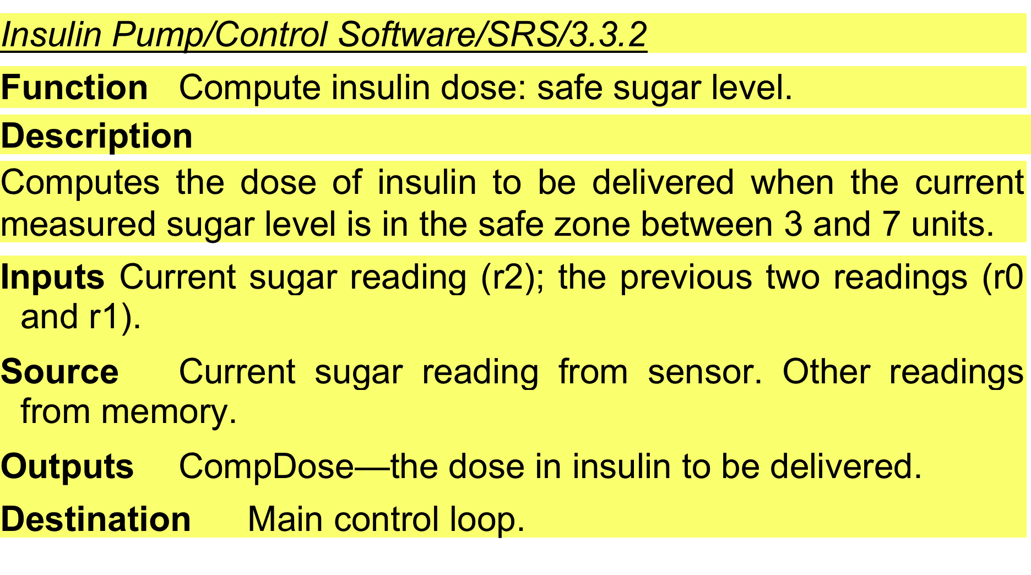
A structured specification of a requirement for an insulin pump

Slide 54
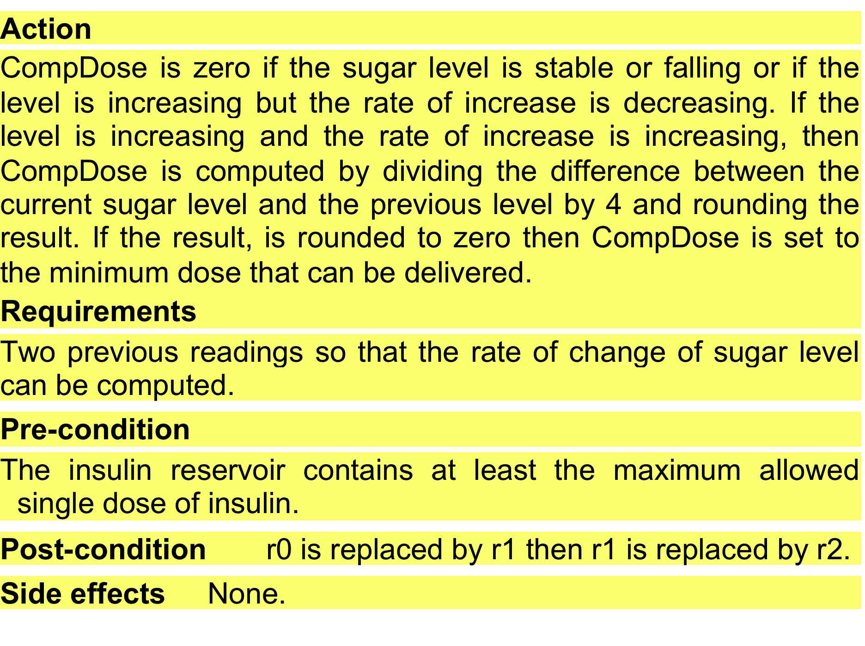
A structured specification of a requirement for an insulin pump

Slide 55
Using structured specifications removes some of the problems of natural language specification. Variability in the specification is reduced and requirements are organized more effectively.
However, it is still sometimes difficult to write requirements in a clear and unambiguous way, particularly when complex computations (e.g., how to calculate the insulin dose) are to be specified.
To address this problem, you can add extra information to natural language requirements, for example, by using tables or graphical models of the system.
These can show how computations proceed, how the system state changes, how users inter act with the system, and how sequences of actions are performed.

Slide 56
Tabular specification
Used to supplement natural language.
Particularly useful when you have to define a number of possible alternative courses of action.
For example, the insulin pump systems bases its computations on the rate of change of blood sugar level and the tabular specification explains how to calculate the insulin requirement for different scenarios.

Slide 57
The following figure is a tabular description of how the rate of change of blood sugar is used to calculate the amount of insulin to be delivered.

Slide 58
Tabular specification of computation for an insulin pump
Condition | Action
Sugar level falling (r2 < r1) | CompDose = 0
Sugar level stable (r2 = r1) | CompDose = 0
Sugar level increasing and rate of increase decreasing ((r2 – r1) < (r1 – r0)) | CompDose = 0
Sugar level increasing and rate of increase stable or increasing ((r2 – r1) ≥ (r1 – r0)) | CompDose = round ((r2 – r1)/4) If rounded result = 0 then CompDose = MinimumDose

Slide 59
Use cases
Use-cases are a kind of scenario that are included in the UML.
Use cases identify the actors in an interaction and which describe the interaction itself.
A set of use cases should describe all possible interactions with the system.
High-level graphical model supplemented by more detailed tabular description.
UML sequence diagrams may be used to add detail to use-cases by showing the sequence of event processing in the system.

Slide 60
Use cases for the Mentcare system

Slide 61
IEEE srs template
Table of Contents
1. Introduction
1.1 Purpose
1.2 Scope
1.3 Definitions, acronyms, abbreviations
1.4 References
1.5 Overview
2. Overall description
2.1 Product perspective
2.2 Product functions
2.3 User characteristics
2.4 Constraints
2.5 Assumptions and dependencies
Notes:
1. Introduction
1.1 Purpose: Define the primary goal of the system and its intended audience.
1.2 Scope: Describe the system's capabilities and limitations within its environment.
1.3 Definitions, Acronyms, Abbreviations: Provide clear definitions for technical terms, acronyms, and abbreviations used. Acronyms:RAM: Random Access Memory
NASA: National Aeronautics and Space Administration
Abbreviations:
Dr.: Doctor
Ave.: Avenue
Inc.: Incorporated
1.4 References: List related documents, standards, and references for better understanding.
1.5 Overview: Summarize the structure and content of the SRS document.
2. Overall Description
2.1 Product Perspective: Explain how the product fits into its environment and relationships with existing systems.
2.2 Product Functions: Provide a summary of the key features and functionalities of the system.
2.3 User Characteristics: Describe the intended user base, including expertise and technical knowledge.
2.4 Constraints: Highlight the limitations, such as hardware, software, legal, or regulatory constraints.
2.5 Assumptions and Dependencies: State any assumptions or dependencies affecting the system.

Slide 62
IEEE srs template
3. External Interface Requirements
3.1 User Interface
3.2 Hardware Interface
3.3 Software Interface
3.4 Communication Interface
4. System Features
5. Other Nonfunctional Requirements
6. Other Requirements
Notes:
3. External Interface Requirements
3.1 User Interface: Specify design requirements for the user interface, such as layout and usability.
3.2 Hardware Interface: Define the hardware components the system interacts with.
3.3 Software Interface: Identify the software systems or APIs the system will integrate with.
3.4 Communication Interface: Describe communication protocols and data formats used.
4. System Features
Detail each system feature or functional requirement, focusing on its purpose and intended behavior.
5. Other Nonfunctional Requirements
Define requirements related to performance, scalability, security, reliability, maintainability, and usability.
6. Other Requirements
Include any additional requirements that don’t fit into the other sections, such as legal, cultural, or operational considerations.

Slide 63
Requirements Engineering Process

Slide 64
Requirements engineering processes
Requirements engineering processes may include four high-level activities.
These focus on assessing if the system is useful to the business (feasibility study),
discovering requirements (elicitation and analysis),
converting these requirements into some standard form (specification),
and checking that the requirements actually define the system that the customer wants (validation).

Slide 65
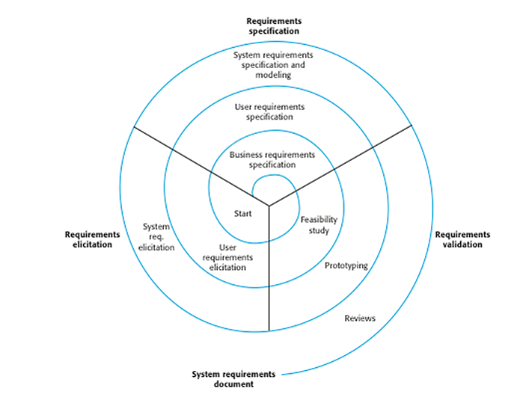
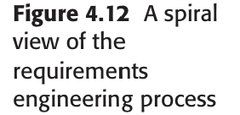
Requirements Engineering Process

Slide 66
The amount of time and effort devoted to each activity in each iteration depends on the stage of the overall process and the type of system being developed.
Early in the process, most effort will be spent on understanding high-level business and non-functional requirements, and the user requirements for the system.
Later in the process, in the outer rings of the spiral, more effort will be devoted to eliciting and understanding the detailed system requirements.

Slide 67
This spiral model accommodates approaches to development where the requirements are developed to different levels of detail.
The number of iterations around the spiral can vary so the spiral can be exited after some or all of the user requirements have been elicited(produced).

Slide 68
Feasibility studies A feasibility study is a short, focused study that should take place early in the RE process. It should answer three key questions:
a) does the system contribute to the overall objectives of the organization?
b) can the system be implemented within schedule and budget using current technology? And
c) can the system be integrated with other systems that are used

Slide 69
Requirements Engineering Process: Steps
1. Feasibility Study
The first step where the project’s feasibility is analyzed from technical, operational, and financial perspectives to determine if it’s worth pursuing.
Example: Before developing a mobile app, checking if the budget, technology, and team capabilities are enough to complete the project successfully.
2. Requirements Elicitation
Gathering detailed requirements from all relevant stakeholders (such as clients, users, and developers) to understand their needs.
Example: Interviewing teachers to find out what features they want in a school management system, like grade tracking or attendance monitoring.
3. Requirements Specification
Writing down the gathered requirements clearly and in detail, usually in a structured format, to create a blueprint for the system.
Example: Documenting that “The website must allow users to create an account using email or social media” as a specific functional requirement.

Slide 70
Requirements Engineering Process: Steps
4. Requirements for Verification and Validation
What it is: Ensuring that the requirements are clear, correct, and achievable and planning how to test and verify that the final system meets the requirements.
Example: Ensuring that the requirement “The system must support 500 users simultaneously” is feasible and specifying how to test it, such as through load testing.
5. Requirements Management
Continuously tracking, updating, and managing changes to requirements as the project progresses, ensuring they stay aligned with the project goals.
Example: If a client asks for an additional feature, like a payment gateway, updating the requirements document to reflect this change and managing its impact on the project timeline and budget.

Slide 71
Requirements elicitation and analysis

Slide 72
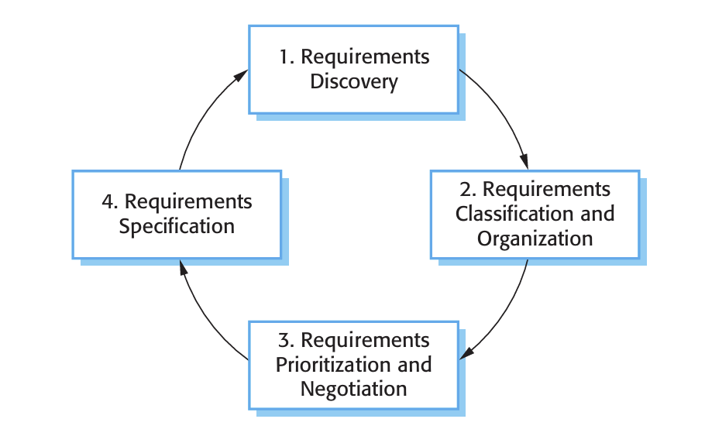
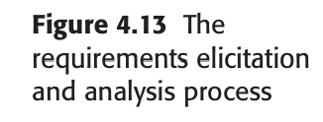
Requirement Elicitation and analysis process
After an initial feasibility study, the next stage of the requirements engineering process is requirements elicitation and analysis.
Definition:
Requirement Elicitation and Analysis Process refers to the process of gathering, analyzing, and organizing the requirements from stakeholders to create a clear, agreed-upon set of needs and expectations for a system.
This process ensures that all stakeholders have a shared understanding of what the system should do and helps organize the work needed to design and build the system.

Slide 73
Steps in Requirement Elicitation and Analysis Process:
1. Requirement Discovery
The process of identifying and collecting all the requirements from stakeholders, users, and any other relevant sources.
Example: Conducting interviews with students and teachers to understand what features are needed in a learning management system (LMS), such as assignments, quizzes, and grade tracking.
2. Requirement Classification and Organization
Sorting and categorizing the collected requirements into different groups (e.g., functional, non-functional) to make them easier to manage.
Example: Grouping requirements for the LMS into categories like "User Management" (account creation, login), "Course Management" (course content, scheduling), and "Performance" (response time, scalability).

Slide 74
Steps in Requirement Elicitation and Analysis Process:
3. Requirement Prioritization and Negotiation
Determining which requirements are most important or urgent and resolving any conflicts or disagreements between stakeholders on priorities.
Example: Deciding that “real-time student feedback” is a higher priority than “advanced course customization” based on stakeholder input and project constraints.
4. Requirement Specification
Clearly documenting and describing the requirements in a structured, detailed format that can be easily understood and referenced during development.
Example: Writing down a specific requirement like “The LMS must allow teachers to upload video files up to 500 MB in size” and including clear criteria for how it will be implemented and tested.

Slide 75
Several techniques can be used to elicit requirements, including:
Interviews: One-on-one conversations with stakeholders to directly gather detailed information about their expectations and specific needs.
Example: Interviewing a project manager to understand the specific reporting features required in a management tool.
Surveys: Questionnaires distributed to multiple stakeholders to gather input on their needs and expectations, useful when reaching a large audience.
Example: Sending out a survey to users of a mobile app to understand what features they want improved or added.
Focus Groups: A small, diverse group of stakeholders who meet to discuss their needs and expectations. This helps identify common needs or conflicting views.
Example: Organizing a session with both customers and customer support staff to discuss key features needed in a new CRM system.
Observation: Watching how stakeholders perform their tasks to identify unspoken needs or challenges that they might not verbalize.
Example: Observing doctors in a hospital setting to identify gaps in the current patient management software.
Prototyping: Creating an early version (prototype) of the system to gather user feedback and validate the requirements in real-time.
Example: Developing a basic prototype of a shopping cart and testing it with users to get feedback on functionality and design.

Slide 76
Requirements validation
Requirements validation is the process of checking that requirements actually define the system that the customer really wants. It overlaps with analysis as it is concerned with finding problems with the requirements.
Requirements validation is important because errors in a requirements document can lead to extensive rework costs when these problems are discovered during development or after the system is in service.

Slide 77
Requirements validation
Requirements Validation is the process of ensuring that the requirements are accurate, clear, and aligned with the stakeholders’ needs and expectations.
It aims to check if the gathered requirements are correct and feasible before moving forward with system development.
During the requirements validation process, different types of checks should be carried out on the requirements in the requirements document
Validity Check
Consistency Check
Completeness Check
Realism Check
Verifiability

Slide 78
Key Activities in Requirements Validation:
1. Validity Check
Ensuring the requirements accurately reflect the stakeholders’ needs and objectives.
Example: If a user requests a feature to “improve search speed,” the requirement should reflect this need precisely, such as “The system should reduce search response time by 50%.”
2. Consistency Check
Verifying that there are no conflicting or contradictory requirements in the documentation.
Example: If one requirement states "The system should allow users to log in using both email and social media accounts," while another states "The system should only allow email login," these requirements need to be aligned.

Slide 79
Key Activities in Requirements Validation:
3. Completeness Check
Ensuring that all necessary requirements are captured, with no important details or functionality missing.
Example: If a shopping cart system is being developed, a completeness check would confirm that all necessary features like adding items to the cart, checking out, and viewing order history are included.
4. Realism Check
Ensuring that the requirements are achievable with the available resources, technology, and within the given time frame.
Example: If a requirement states that "The system should handle 1 million users simultaneously," a realism check would evaluate if the current infrastructure can support this load.

Slide 80
Key Activities in Requirements Validation:
5. Verifiability
Making sure that each requirement can be tested or verified during the later stages of development.
Example: A requirement such as "The system should respond to user queries in under 2 seconds" is verifiable because it can be tested and measured in terms of response time.

Slide 81
Requirements management
Requirements Management is the process of tracking and managing changes to requirements throughout the lifecycle of a project.
It ensures that the system being developed meets the evolving needs of stakeholders, and all requirements are up to date and correctly implemented.
Why Change is Inevitable:
Evolving Stakeholder Needs: As projects move forward, stakeholders may discover new needs or shift their priorities.
Technological Advancements: New technologies or tools might become available, requiring updates to the system.
External Factors: Changes in laws, market trends, or competition can lead to necessary adjustments in requirements.
Feedback from Prototyping/Testing: Early versions or tests may highlight issues or gaps in the original requirements.

Slide 82
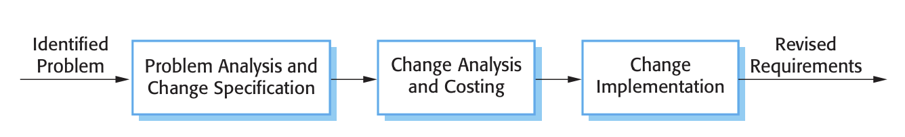
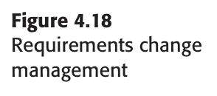
Requirements management
Steps in Requirements Change Management:

Slide 83
Requirements management
Steps in Requirements Change Management:
1. Identify the Problem
Recognizing the need for a change in the requirements, often due to new information, stakeholder input, or an issue discovered during development.
Example: A stakeholder reports that the mobile app's current design does not work well on small screens, requiring a change in layout.
2. Problem Analysis and Change Specification
Analyzing the problem to understand its impact and clearly specifying the necessary changes to the requirements.
Example: Analyzing why the current design isn't user-friendly and specifying that the layout needs to be adjusted for better readability on smaller devices.

Slide 84
Requirements management
Steps in Requirements Change Management:
3. Change Analysis and Costing
Analyzing the potential impact of the change on the project in terms of time, resources, and cost.
Example: Estimating the additional development time and cost to redesign the layout and implement the changes for all screen sizes.
4. Change Implementation
Carrying out the changes in the system, which may involve coding, testing, and updating documentation.
Example: Redesigning the app layout, updating the user interface code, and testing it to ensure it works on both large and small screens.

Slide 85
Requirements management
Steps in Requirements Change Management:
5. Revised Requirement
Updating the requirement documentation to reflect the changes made, ensuring that the system reflects the new needs and specifications.
Example: Updating the requirements document to include the revised mobile layout and ensuring it aligns with user experience goals.

Slide 86
Requirements management
Three Principal Stages to a Change Management Process:
Problem Analysis and Change Specification
Identifying the root cause of the issue and clearly defining the changes needed to resolve it.
Example: Recognizing that the mobile app’s interface is confusing and specifying that a more intuitive design is required.
Change Analysis and Costing
Analyzing the effects of the change on the overall system, project scope, timeline, and budget.
Example: Determining how long it will take to implement the design change and how it will impact the project’s budget.
Change Implementation
Implementing the approved changes, including modifying the system, testing, and updating documentation.
Example: Applying the design changes, testing the new layout on multiple devices, and revising the requirement document to reflect the updates.

Slide 87
Software Cost Estimation
Definition:
Software Cost Estimation is the process of predicting the amount of effort, time, and resources required to develop a software system.
It helps in planning, budgeting, and allocating resources effectively during software development.
Key Factors in Software Cost Estimation:
Project Size: The complexity and scale of the software, such as the number of features and functions.
Technology Used: The tools, frameworks, and programming languages chosen for the project.
Team Experience: The skill levels and experience of the development team.
Project Requirements: The clarity and scope of the requirements, as unclear requirements can lead to more time and effort.
Development Time: The duration it takes to complete different stages of development.

Slide 88
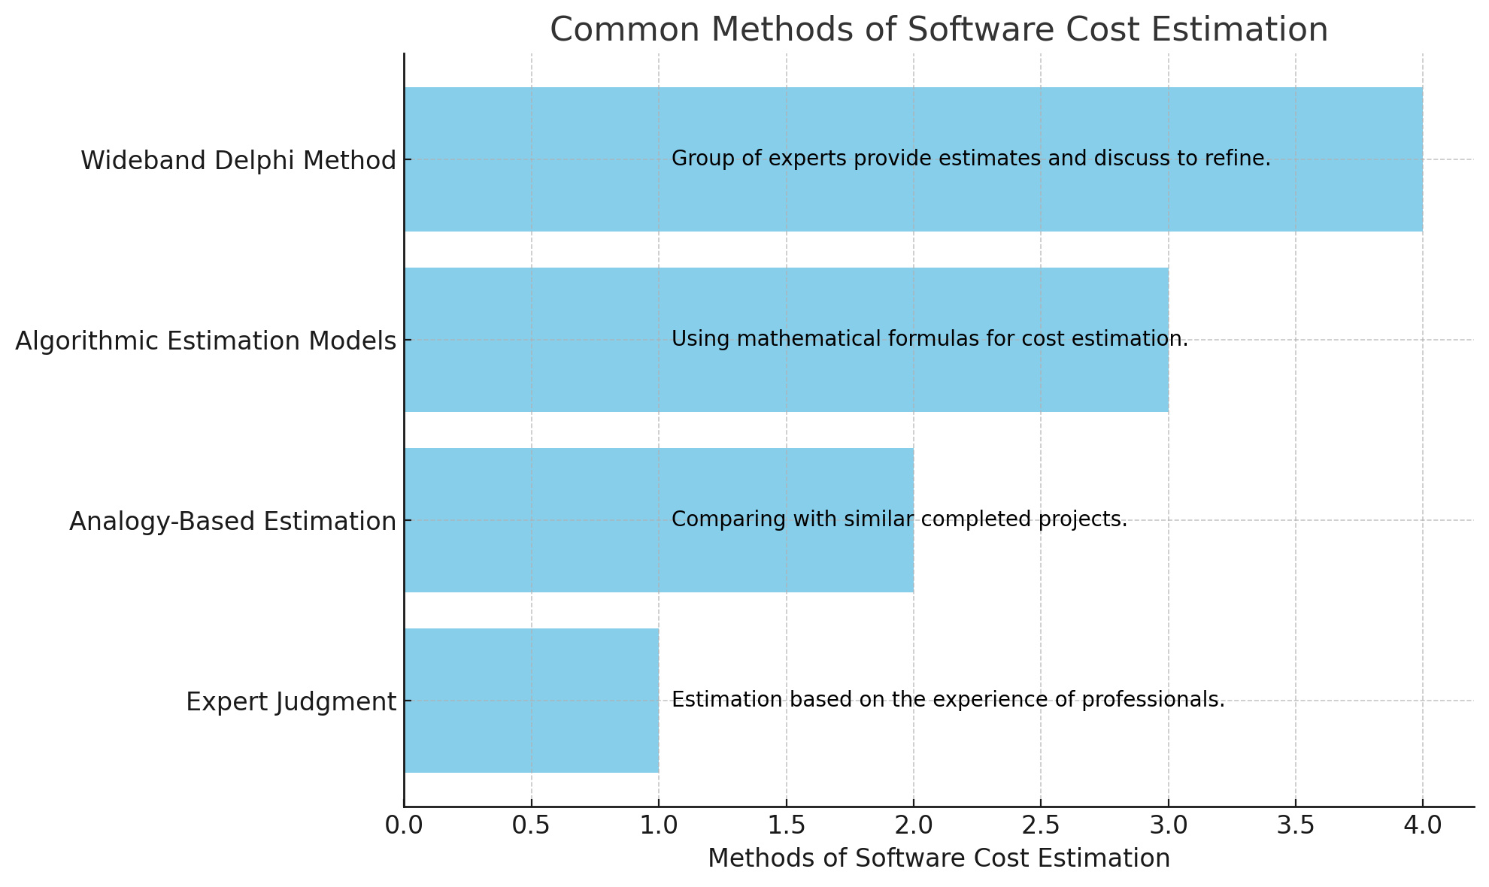
Software Cost Estimation
Common Methods of Software Cost Estimation:

Slide 89
Software Cost Estimation
Common Methods of Software Cost Estimation:
Expert Judgment: Estimation based on the experience of professionals who have worked on similar projects. Example: A senior developer may estimate the cost based on their prior experience with similar projects.
Analogy-Based Estimation: Comparing the current project to similar completed projects to estimate the cost. Example: Estimating the cost based on a previous project that had similar features and scope.
Algorithmic Estimation Models: Using mathematical formulas to estimate cost based on factors like project size, complexity, and effort.
Example: Using models like COCOMO (Constructive Cost Model) or Function Point Analysis to estimate cost.
Wideband Delphi Method: A group of experts provides estimates and discusses them to arrive at a consensus. Example: A team of developers and project managers work together to give cost estimates, and then refine them based on group discussions.

Slide 90

Thank You

